Slide 1
2 B
STARS AND STRIPES

Slide 2
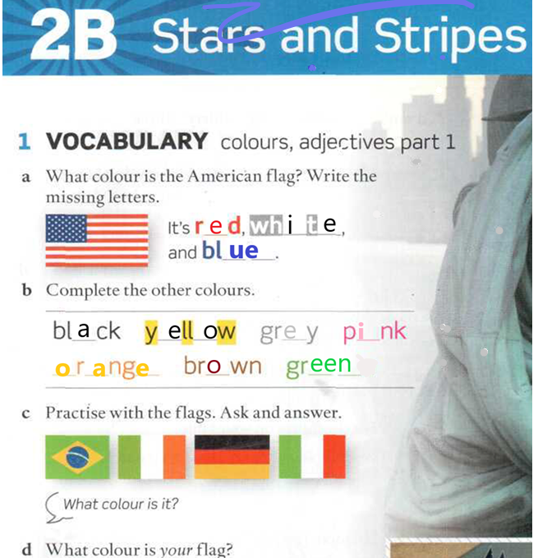


Our national flag is a triband with horizontal stripes, light blue and white.

Slide 3
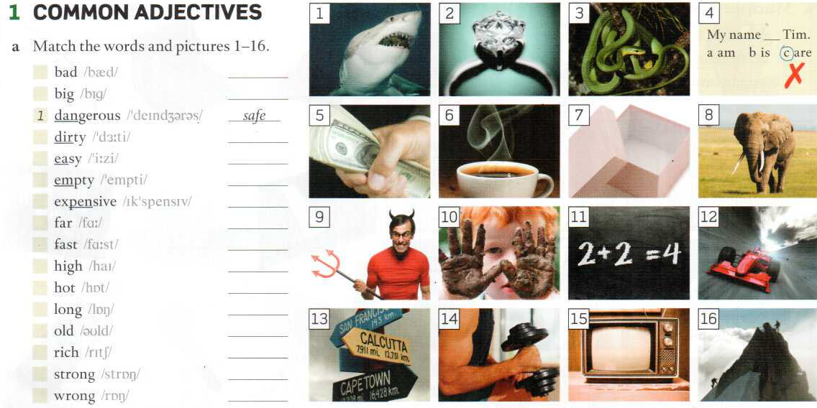
ADJECTIVES
Page 152
Repeat, and memorize.

Slide 4
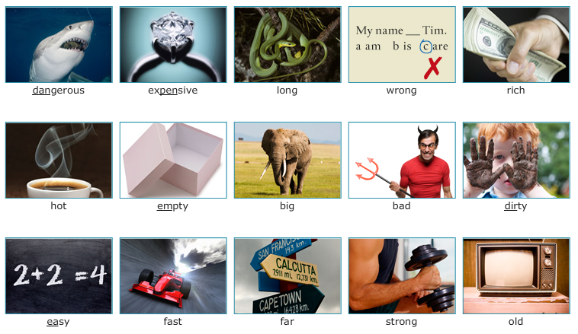

Slide 5
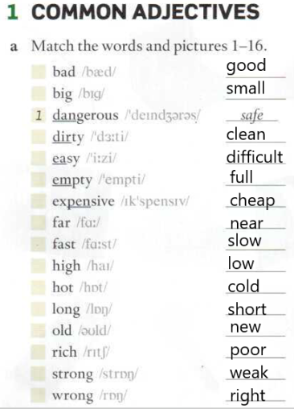

Slide 6
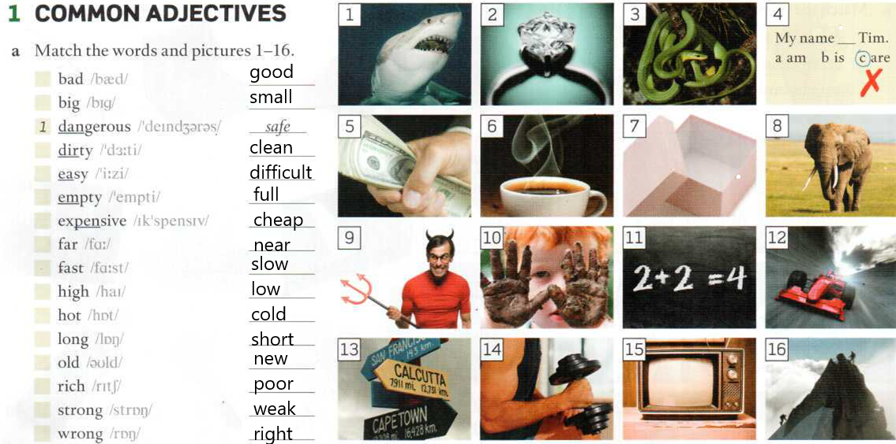

Slide 7
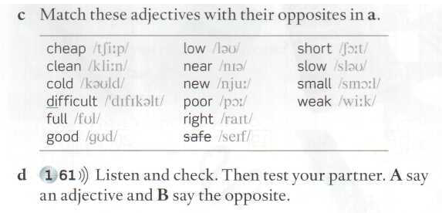
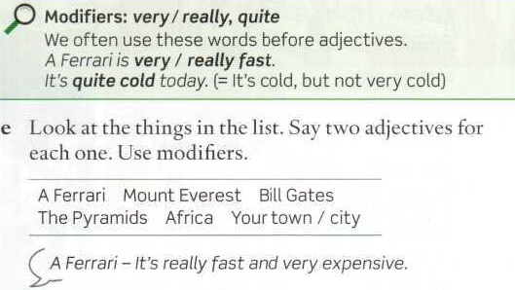
OPPOSITE ADJECTIVES
Page 152
Listen and write the opposites.

Slide 8
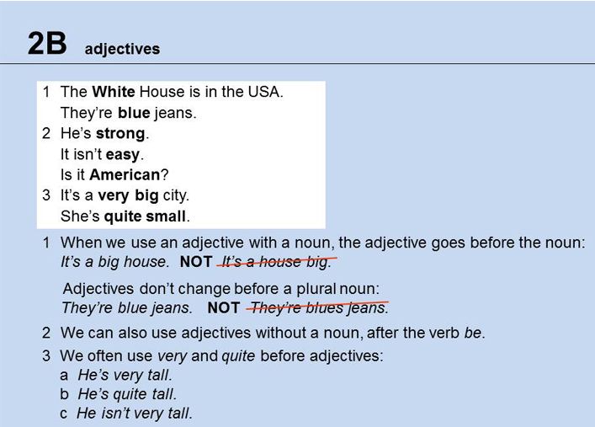
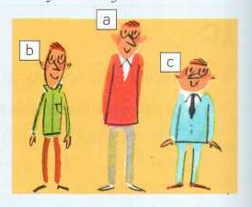
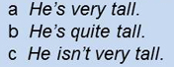
Listen and repeat these sentences

Slide 9
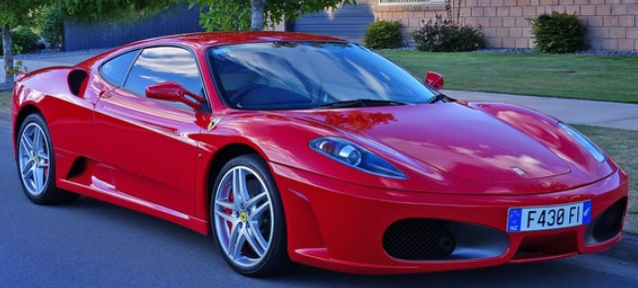
Position of adjectives:
BEFORE THE NOUN: an expensive car A Ferrari is an expensive car.
AFTER THE VERB BE: It is expensive This car is expensive.

Slide 10
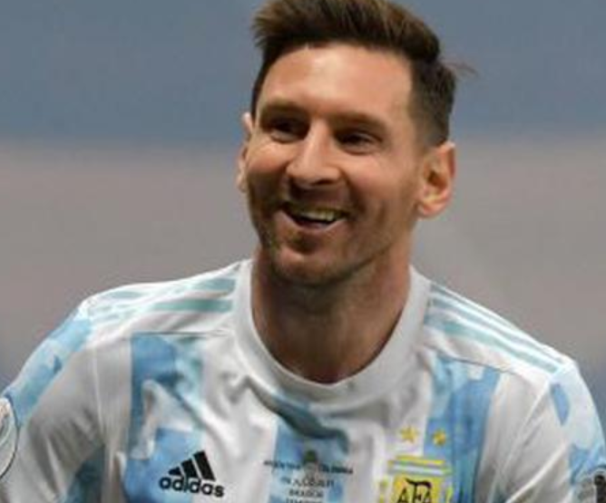
Messi is a footballer. (noun)
Messi is a good footballer. (adjective + noun)
Messi is good. (Be+adj)
Messi is a very good footballer
Messi is a really good footballer.
Messi is very good.
Messi is really good.
Messi is quite good.

Slide 11
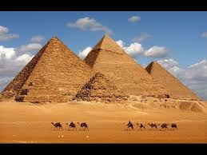
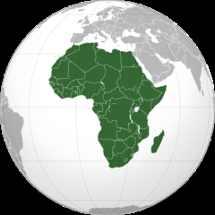
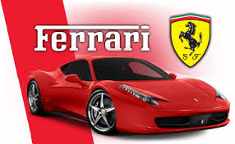
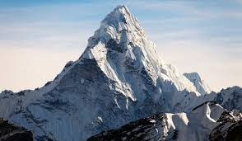
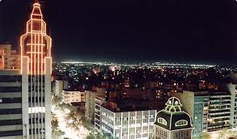
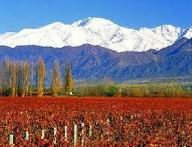
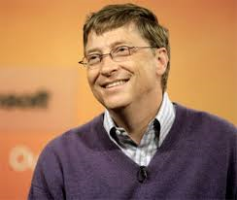
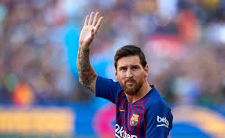
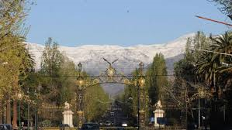
MODIFIERS
very/
really
quite
Mount Everest is very high and cold.
Bill Gates is American and very rich.
The Pyramids are very old and very big.
Africa is very hot and quite poor.

Slide 12
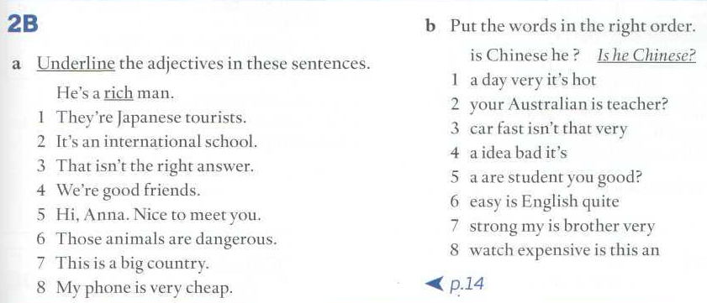
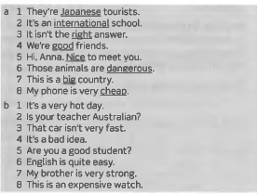
1- It’s a very hot day.
2- Is your teacher Australian?
3- That car isn’t very fast.
4- It’s a bad idea.
5- Are you a good student?
6- English is quite easy.
7- My brother is very strong.
8-This is an expensive watch.

Slide 13
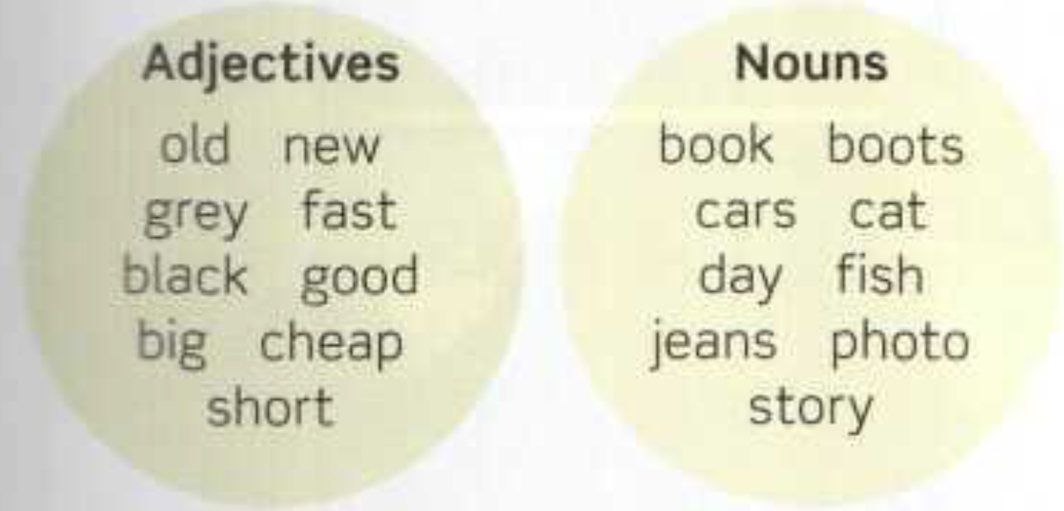
Dictation:
Write down the phrases containing adjectives. (Pause after each one)
1. an old photo
2. new boots
3. a grey day
4. fast cars
5. a black cat
6. a good book
7. a big fish
8. cheap jeans
9. a short story

Slide 14
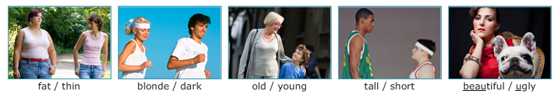

Slide 15
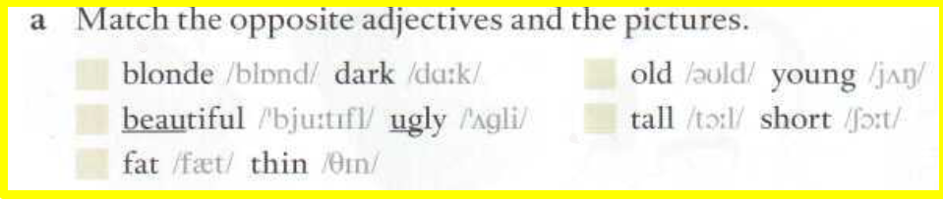
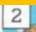
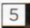
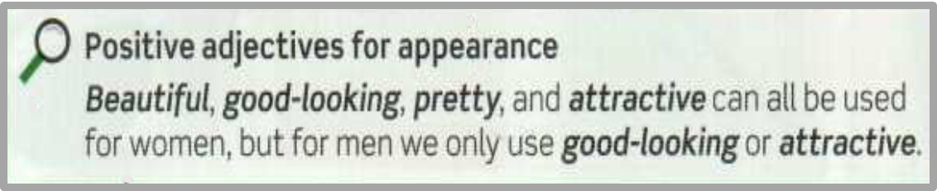
APPEARANCE ADJECTIVES
Page 152.

Slide 16
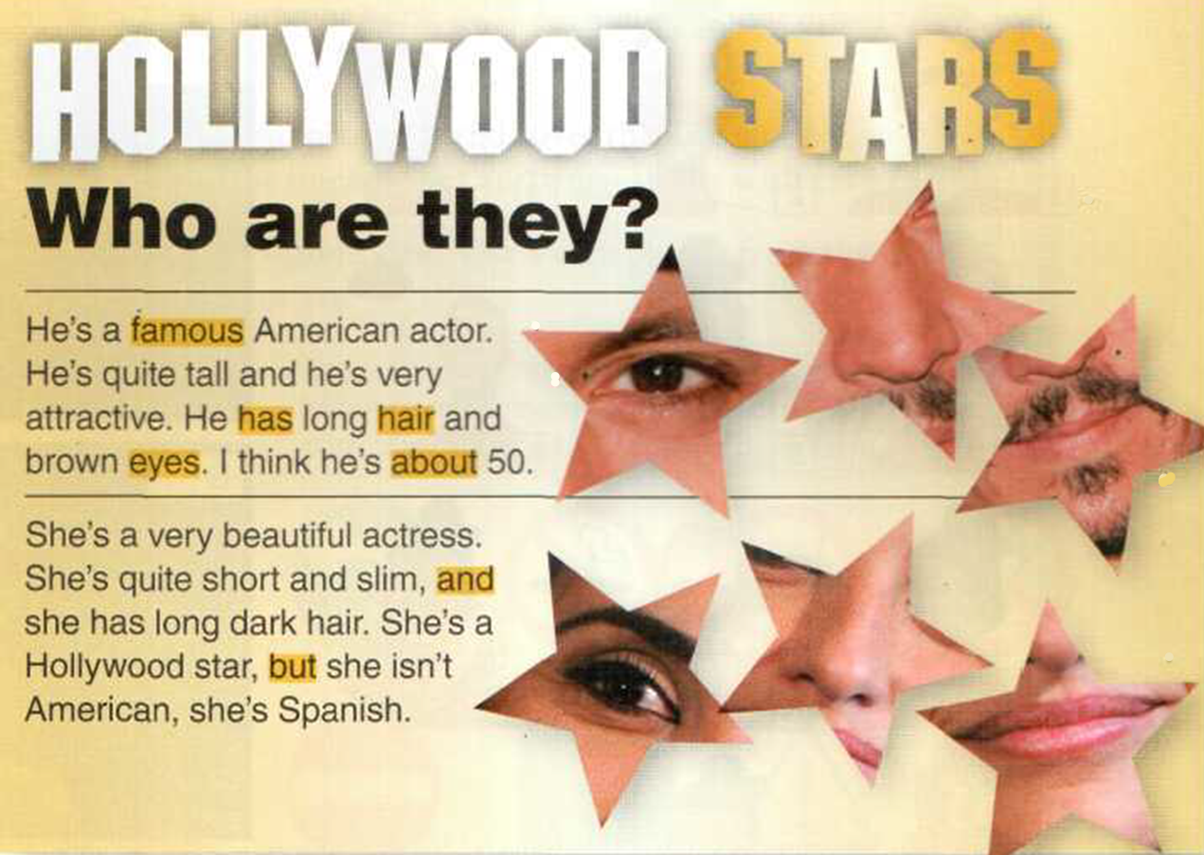
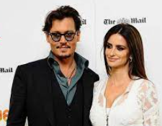
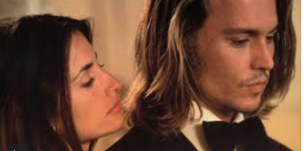

Slide 17
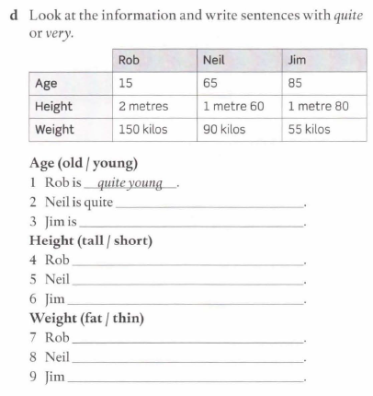
Workbook Pages 13 and 14
old
is very old
is very tall
Is quite short
Is quite tall
is very fat
is quite fat
is very thin

Slide 18
1 They're jeans blue I blue jeans.
2 It's a nice day I day nice.
3 My sisters are very tall I very talls.
4 That's a car fast I fast car.
S These are goods photos I good photos.
6 Those boots are quite cheap I quite cheaps.
7 It's a big house I house big.
8 Her children aren't very oIds I very old.

Slide 19
Write the colours
1 blue + yellow
2 black + white
3 red + yellow
4 white + red
5 red + green
GREEN
GREY
ORANGE
PINK
BROWN

Slide 20
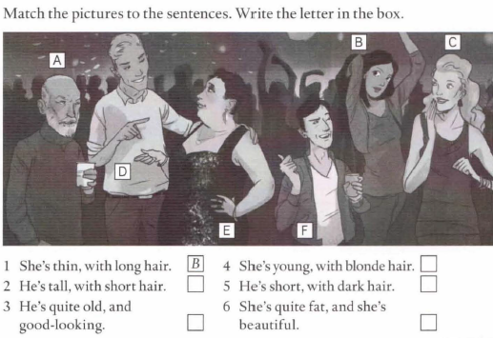
WB PAGE 13

